Slide 1
Programming Refresher
Notes:
Let's start with a quick refresher on Python programming basics.

Slide 2
Programming Basics
Notes:
Let's start with the fundamentals of programming.

Slide 3
Classify different types of software and explain their distribution methods to understand the various ways software is distributed
Differentiate between procedural, object-oriented, and functional programming paradigms to select the best one for your use case
Construct a well-defined program structure to write syntactically correct code snippets
Utilize various IDEs and programming tools to write and debug code effectively
Notes:
Read the learning objectives

Slide 4
Business Scenario
ABC is a supply-chain management company. The development team at ABC is creating software to manage their clients' product supply chains. This software can be either a web or a desktop application installed in all warehouses.
The company needs to decide which type of software will best meet its needs and how to use programming techniques to implement it.
Notes:
Discuss the above-mentioned business scenarios and have a discussion with the class

Slide 5
Introduction to Software
Notes:
Let's explore the basics of software and its significance.

Slide 6

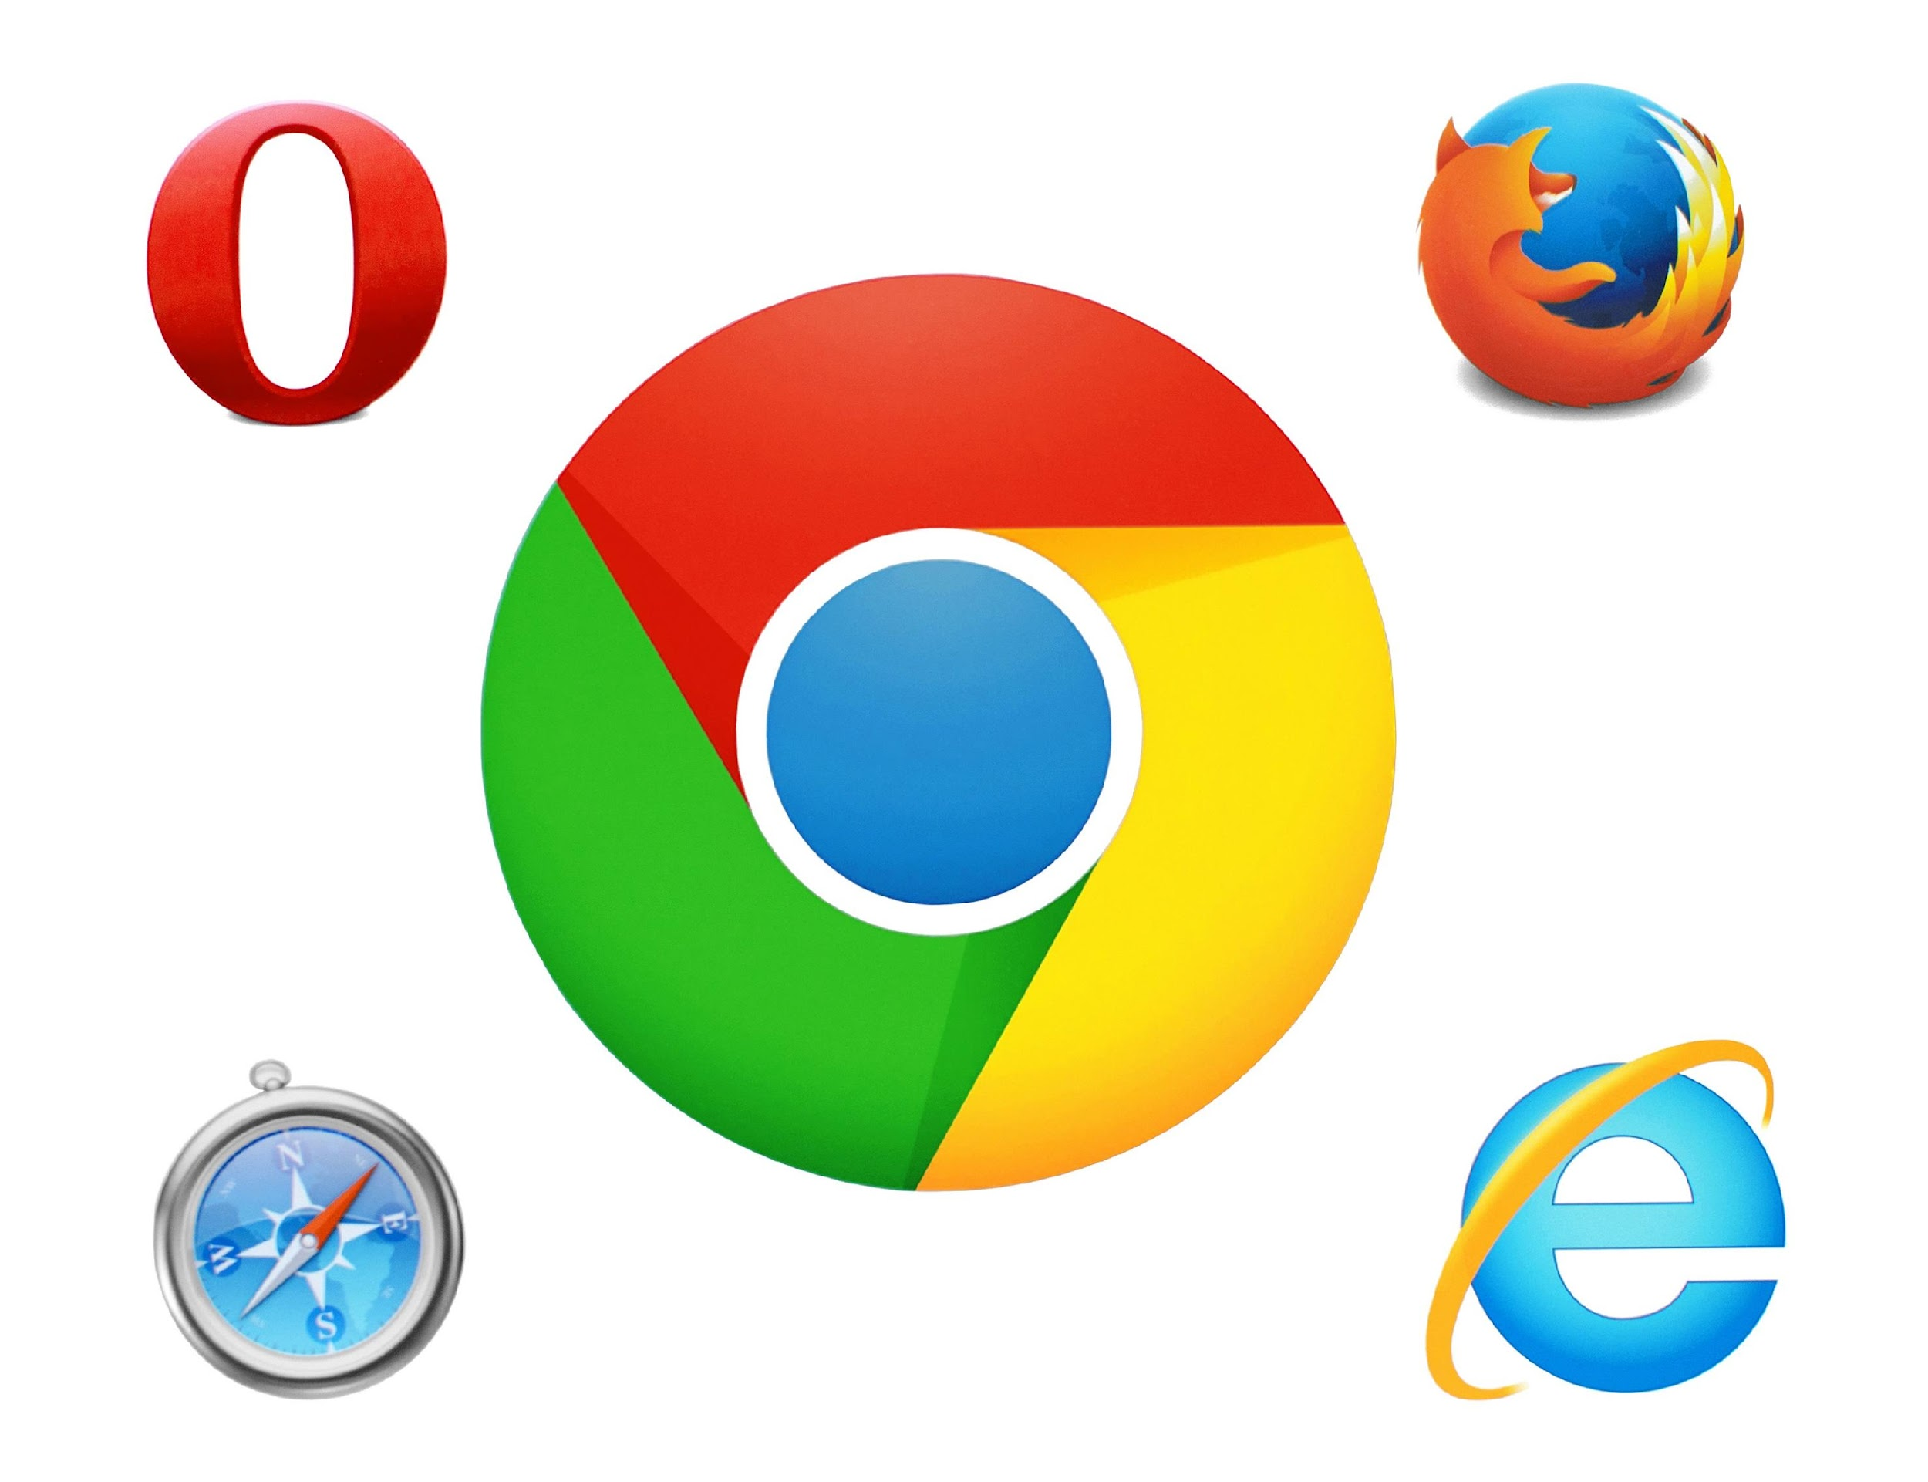


What Is Software?
Software is a set of instructions written for the computer to understand, interpret, and execute.
Software programs are structured, organized, and formally written in a computer language. Hardware runs software programs.
Without software support, hardware cannot increase its capabilities. The network and computer systems cannot function without software programs.
Notes:
This slide is self explanatory

Slide 7



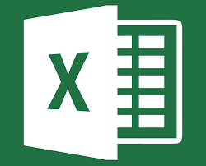

Software: Examples
Operating system
Internet browser
Adobe
Spreadsheet
Office
Notes:
This slide is self explanatory

Slide 8
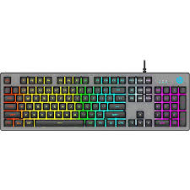



Hardware: Examples
Hardware is a physical electronic device used in or with a machine. Some examples of hardware in a computer are:
Mouse
Keyboard
Ethernet cords
Hard drive
Notes:
This slide is self explanatory

Slide 9
Why Do We Need Software?
The software makes human tasks easier and provides a consistent way of executing instructions with minimal to zero error, unlike execution done by human beings.
1
Software, such as commercial off-the-shelf software, can be customized for any organization or user and designed for the mass market.
2
For instance, a calculator comes with software that makes regular calculations simpler and faster.
Note
3
Notes:
Software simplifies human tasks and ensures accurate execution of instructions, eliminating or minimizing errors that may occur with human involvement. It can be tailored to suit specific organizational or user needs, and can also be designed for widespread use, such as commercially available software. As an example, a calculator incorporates software that enhances efficiency and speed in performing routine calculations.

Slide 10

Why Do We Need Software?
Software has evolved with the advancement of technology.
In today’s era, software can create complex enterprise applications for various industries, such as transportation, medicine, defense, and telecommunications.
Note
Notes:
The software has experienced remarkable evolution in line with technological advancements. In today's era, it enables the creation of sophisticated enterprise applications across diverse industries such as transportation, medicine, defense, telecommunications, and more.

Slide 11
Categories of Software
Notes:
Let's understand the different categories of software and their purposes.

Slide 12
Types of Software
Software can be broadly classified in two categories:
Application software
Photoshop
Calculator
Microsoft Office
System software
Application software
System software
Browser
Games
Operating system
Hardware
CPU, RAM, I/O devices, and others
Utilities
Notes:
Software can be broadly classified into two categories: system software and application software. System software includes hardware components and the operating system, while application software refers to programs designed for specific tasks or user functionality.

Slide 13
System Software
It acts as an interface between hardware and application software. These programs run background processes. System software can be categorized based on its functions. The machine understands binary language, and system software helps convert human instructions into machine-understandable instructions.
Example
Operating systems such as Windows, macOS, Linux, UNIX, Android, and iOS
Utilities such as antivirus software, backup software, and file management tools
Notes:
In system software, the operating system manages computer resources, utility programs aid in system maintenance, and language translators convert programming code into executable instructions.
It acts as an interface between hardware and application software.
These software run background processes.
Machine understands binary language and system software helps to convert human instructions into machine understandable instructions.
System software can be categorized based on its functions.

Slide 14
Application Software
It is a set of programs that perform a specific task on a system. These are customized to solve specific problems and provide functionalities.
Example
Excel is used for operations with numbers.
PowerPoint creates presentations.
A browser is used for surfing the internet.
A library management system provides functionalities related to the library.
A tally is used for accounting.
Notes:
This slide is self explanatory

Slide 15
Distribution of Software
Freeware
Shareware
It refers to software that is freely available without any charge. It is typically released under a freeware license, which allows users to use, copy, distribute, and modify the software without any restrictions.
It is typically released under a shareware license. It is a time-limited, free software that requires payment for continued use after the trial period.
Notes:
Freeware refers to software that is freely available without any cost, allowing users to use, copy, distribute, and modify it without restrictions. It is released under a freeware license.
Shareware, on the other hand, is time-limited free software that is typically released under a shareware license. Users can try the software for a specific trial period, and after that period, payment is required for continued use.

Slide 16
Distribution of Software
Open-source software
Licensed software
It is often released under an open-source license and enables unrestricted usage, modification, and distribution. Its source code is generally accessible to the public, fostering inspection and improvement by a wide range of individuals.
It is protected by copyright and must be purchased from a vendor. It is governed by a proprietary license, granting users usage rights but not allowing them to modify or distribute the software.
Notes:
Open-source software is typically released under an open-source license, allowing unrestricted usage, modification, and distribution. Its source code is publicly accessible, enabling inspection and improvement by a diverse community.
Licensed software, on the other hand, is protected by copyright and must be purchased from a vendor. It is governed by a proprietary license, which grants users usage rights but does not permit modification or distribution of the software.
Now that you have learned about software and its distribution methods, let us examine the aspects of programming.

Slide 17
Programming Models
Notes:
Let's explore different programming models.

Slide 18
Procedural Programming
Procedural programming is a programming paradigm built around the idea that programs are sequences of instructions to be executed.
A program is divided into multiple sections called modules, subroutines, or block structures. The aim is to improve the clarity, quality, and development time of a computer program.
Instead of using a go-to statement like assembly language, procedural programming (structured programming) uses blocks, control structures, and loops.
Example: Pascal and C
Notes:
Programming is the process of designing and writing computer programs. It involves creating a set of instructions that a computer can execute to perform specific tasks or solve problems.
Procedural programming is the first programming model.

Slide 19
Object-Oriented Programming Language
OOP refers to languages that use objects in programming. It aims to implement real-world entities such as inheritance, information hiding, and polymorphism in programming.
Example: C++ and Java
Advantages of OOP
Executes programs faster and easier
Provides a clear structure for programs
Offers more security than procedural languages
Allows objects to move freely within member functions
Helps create reusable applications with less code and shorter development time
Notes:
Object oriented programming is the second programming model.

Slide 20
OOP: Principles
OOP focus on the following principles:
Inheritance
Encapsulation
Abstraction
Polymorphism
Notes:
OOP Concepts:
Abstraction
Encapsulation
Inheritance
Polymorphism

Slide 21
Functional Programming
Functional programming is a programming paradigm where programs are constructed by applying and composing functions.
It emphasizes the use of pure functions and higher-order functions, treating computation as the evaluation of mathematical functions without changing state or data.
Functional programming provides a structured and predictable approach to software development, offering numerous advantages in terms of reliability, maintainability, and concurrency, which are essential in modern computing environments.
Example: Scala
Notes:
Functional programming is the third programming model.

Slide 22
Program Structure
Notes:
Let’s have a look at the overall structure of a program.

Slide 23
Program Structure
A program consists of multiple components that interact with each other and have interrelationships. A well-structured program might be complex but not complicated.
1
In a well-structured program, the division into components follows a recognized principle, such as information hiding, and the interfaces between components are explicit and simple.
2
Notes:
Program Structure:
A program is composed of multiple components that interact and have interrelationships. A well-structured program may be complex, but it is not complicated. It follows recognized principles, such as information hiding, where components are divided accordingly. The interfaces between components are explicit and simple, ensuring clarity and ease of interaction.

Slide 24
Program Structure
In contrast, a poorly structured program has interfaces that are implicit and difficult to understand, and the division into components is largely arbitrary (or non-existent).
3
A well-structured program employs appropriate data structures and program units with a single-entry point and a single exit point, while a poorly structured program employs arbitrary data structures and flow of control.
4
Notes:
In contrast, a poorly structured program lacks explicit interfaces and has arbitrary or non-existent division into components. It also lacks appropriate data structures and program units, leading to unclear control flow. On the other hand, a well-structured program utilizes clear interfaces, appropriate data structures, and program units with a single-entry and single-exit point, promoting clarity and maintainability.

Slide 25
Structured Program
All structured programs share a similar overall pattern, as shown below:
Variable declaration
2
Statements to start the program
1
3
Program statements
(blocks of code)
Notes:
This slide is self explanatory

Slide 26
Syntax in Different Languages
The programming languages listed below support the following syntax:
Language | Syntax example
C | #include<stdio.h> void main(){printf(“Hey Hi!!”);}
C++ | #include<iostream> int main(){cout<<(“Hey Hi!!”; return 0;}
Pascal | program HelloWorld; begin writeIn(“Hey Hi!!”); end
Oracle PL/SQL | CREATE OR REPLACEPROCEDURE helloworld AS BEGIN DBMS_OUTPUT.PUT_LINE(‘HELLO WORLD’); END;
Notes:
This slide is self explanatory

Slide 27
Syntax in Different Languages
The programming languages listed below support the following syntax:
Language | Syntax example
Java | class helloworld{ public static void main (String args []) { System.out.printIn(“Hello World!!”);}}
Perl | #!/usr/bin/env perl use strict; use warnings; print “Hello World”;
Basic | print “Hello World”
Notes:
This slide is self explanatory

Slide 28
Types of Programming Language
Programming languages can be compiled or interpreted.
Compiler-based language | Interpreter-based language
A compiler takes the entire program in one go. | An interpreter takes a single line of code at a time.
The compiler generates intermediate machine code. | The interpreter never produces any intermediate machine code.
The compiler is best suited for the production environment. | An interpreter is best suited for a software development environment.
Programming languages, such as C, C++, C#, Scala, and Java are compiler-based languages. | Python, Ruby, PHP, and Perl are interpreter-based languages.
Notes:
This slide is self explanatory

Slide 29
Programming Concepts
There are five basic concepts used in any programming language.
Variables
Tools
Control structures
Syntax
Data structures
Notes:
This slide is self explanatory

Slide 30
Variables
A variable is a storage location with an associated symbolic name that contains some known
or unknown quantity or information, that is, a value.
Example
int no;
string name;
double amount;
In some programming languages, it is important to specify the type of value
that will be stored in the variable, known as the data type.
Notes:
A variable is a storage location identified by a symbolic name, capable of holding a value, whether known or unknown, representing quantity or information.

Slide 31
Control Structures
Control structures direct the program's flow depending on a decision, causing it to jump from one line to another or return a section of code. It can be done using an if-else construct.
Example
if (age >= 18)
“a person can vote “
else
“a person cannot vote “
It controls the flow of the program structure. When a program runs, a compiler reads and executes
the user program line by line. This is called the top-to-bottom approach.
Notes:
In real situations, to control the flow of the program based on some decision and make it jump from one line to another or return a piece of code control structures are used. It can be done using an if-else construct.

Slide 32
Data Structures
Data structures are a way of storing and organizing data on a computer that can be effectively used. Lists, dictionaries, and arrays are a few examples of data structures.
Example
To store a list of contacts for 100 people, instead of creating 100 variables, a data structure like a list or array can store these contacts.
Notes:
In computer science, a data structure is a particular way of storing and organizing data in a computer so that it can be used efficiently. Many data structures are available, such as lists, dictionaries, arrays, maps, etc.

Slide 33
Syntax
Syntax defines a set of rules that specify the combinations of symbols that are correctly structured statements or expressions in that language.
Example
String name = “Jack Ford”;
Symbols, characters, and words in a programming language have special meanings and rules to
enable the compiler to understand the instructions.
Notes:
When we learn a language, we learn the grammar and the rules of the language to be able to properly frame the sentences and convey our meaning to others.
In the same way, in a programming language, the symbols, characters, and words have special meanings and rules defined to enable coding in a structured format so that the compiler can understand the instructions.

Slide 34
Tools
Tools in programming are the editors that help the user code quickly and efficiently.
Example
Eclipse
Atom
Jupyter
Microsoft Visual Studio
There are various IDEs (Integrated development environments) available for coding based on technology and language.
Notes:
Trainer Notes:
Tools in programming are the editors that help you code quickly and in an efficient manner.
There are various IDEs ( Integrated Development Environment ) available for coding based on the technology and language you are coding for.

Slide 35
Software is a set of instructions given to the computer to process and provide the desired output.
Software can be categorized based on its purpose into system or application software.
Procedural, object-oriented, and functional programming are the three types of programming models.
A program must be well-defined and structured to enhance, scale, and extend its capabilities for future requirements.
Notes:
This slide is self explanatory

Slide 37
The language understood by a computer without translation is called ____________
1
Command language
High-level language
Assembly language
Machine language

Slide 38
The language understood by a computer without translation is called ____________
1
Command language
High-level language
Assembly language
Machine language
D
The computer understands machine language without translation.

Slide 39
Which of the following software defines an operating system and utility program?
2
System software
Application software
Device driver
Customized software

Slide 40
Which of the following software defines an operating system and utility program?
2
System software
Application software
Device driver
Customized software
A
Operating systems and utility programs are examples of system software.

Slide 41
Thank You!
Notes:
Thank you

